Slide 1
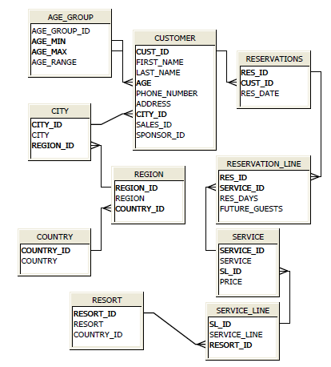
Data Model – Sample queries to practice
Find out the resorts where both customer ‘Tim’
and customer ‘Bill’ stayed.
Find out the services which are available in the
resort ‘Taj Club’ but not in ‘Taj Metro’
Display customer name, age group, city, region
and country who has reserved ‘Boat services’
Write a query to find customers who are
aged between 60 and 70 and who have
reservation in the next month in India resorts.
Display the regions where we have more than
10 cities.
Display age group wise customer count.
Display resort_name, resort_country,
customer_name and customer_country based on
the reservations table.
What is the costliest service in each service_line?
Display the result which displays service_name,
price, maximum_price with in the service line.
Display country_name, number of regions and
number of cities for each country.
Display the number of reservations we have based
on each resort.

Slide 2
OLTP Model of resort
OLAP Model of resort
Calendar_dim
----------------------
Cal_date
Cal_week
Cal_day
Cal_month
Cal_quarter
Cal_year
service_dim
-----------------
Service_id
Serice_name
service_line
Resort_name
Country_name
Reservation_fact
----------------------
Res_id
Cust_id
Res_date
Service_id
Res_days
Number_of_guests
Price_of_service
Reservation_revenue
Customer_dim
--------------------
Cust_id
Cust_f_name
Cust_l_name
Age_range
Phone_number
Address
City_name
Region_name
Country_name
Create Views to replicate the star schema based on the OLTP Model.
When those views performance is bad, then we convert those views into materialized views

